Slide 1
Overview of the Attendance Messaging Project (AMP)
Washoe County School District Pilot to Reduce Chronic Absenteeism
September 27, 2018
Notes:
Adapted from the Attendance Messaging Implementation Training held on September 27, 2018

Slide 2
Notes:
Graph displays chronic and severe chronic absenteeism across all grade levels in the WCSD in SY 2017-18: 15% (4562 of 30577) of K-5 students were chronically absent (underlined blue).
Graph reads “Of the students enrolled in kindergarten in school year 2017-18, 20 percent of them were chronically absent.”

Slide 3
Attendance Myths
Attendance does not affect academic/well-being outcomes
Only unexcused absences matter
Sporadic absences aren’t a problem & tardies are okay
The number days absent is less among my students/children
Attendance is not very important in early grades
Fact: Beliefs about education shape how we support attendance.
Source: Robinson, C., Lee, M., Dearing, E., & Rogers, T. (2017). Reducing Student Absenteeism in the Early Grades by Targeting Parental Beliefs. HKS Faculty Research Working Paper Series.
Notes:
Beliefs about attendance, including the myths we subscribe to, influence how we support attendance as parents, educators, and policy makers.

Slide 4
The Promise of Text Messaging
Texts have a 98% open rate & email open rate in education is 26% (Pew 2015)
Easy to implement, low cost
Targeting beliefs mobilizes parental involvement: Messages emphasize value of attendance & give updates on students’ attendance (Robinson et. al. 2017)
Early research suggests impact on attendance (Smythe-Leistico & Page 2018)
Notes:
AMP should not replace more intensive attendance-focused efforts, such as attendance officers, social workers, and mentors. Many factors contribute to poor attendance, such as poverty and family instability, that cannot be solved by a message-based intervention. Schools might employ this intervention as a first step towards reducing chronic absenteeism, and then target the more costly, intensive attendance-focused efforts on the students who need it most.
Citations
Information adapted from: A Research Review of Evidence-Based Text Messaging Programs for Families, Benjamin N. York, Ph.D., Founder and CEO, ParentPowered PBC. National Invitational Webinar for Promoting Child Outcomes, August 2, 2018.
Pew Research Center, April, 2015, “The Smartphone Difference” Available at: http://www.pewinternet.org/2015/04/01/us-smartphone-use-in-2015
Kenneth Smythe-Leistico & Lindsay C. Page (2018) Connect-Text: Leveraging Text-Message Communication to Mitigate Chronic Absenteeism and Improve Parental Engagement in the Earliest Years of Schooling, Journal of Education for Students Placed at Risk (JESPAR), 23:1-2, 139-152, DOI: 10.1080/10824669.2018.1434658

Slide 5
AMP Goals
Intervene early to prevent & interrupt chronic absenteeism
Improve attendance: reduce tardies & absences
Increase two-way communication between school staff & families
Affect parent beliefs about attendance
Determine feasibility & effectiveness of AMP

Slide 6
AMP Elements
Bi-weekly informational message for all students via text & email
Two-way communication triggered at 93% attendance threshold
Same-day positive messaging when student returns to school via text & email
Same-day absenteeism notification
Element 2 applies to students enrolled for at least 10 consecutive days
Notes:
Includes students who are enrolled for 10 consecutive days.
Heavy focus on early intervention and prevention with a lot of initial contact early in semester and easing over time.

Slide 7
Bi-weekly informational message
Two-way communication at 93% attendance
Positive message when students return to school
AMP Elements
Fosters relationships between parents & staff most knowledgeable of students’ academic needs. Provides opportunity to uncover barriers to attendance.
Informs & motivates parents: Challenges misconceptions that undervalue attendance.
Reinforces attendance, expresses care for student, & serves as a reminder to complete missed work.

Slide 8
AMP Elements
Two-Way Communication
Triggered at 93% attendance
Phone call or face to face contact
Established by school staff who:
knows the student & family (e.g., teacher)
or
commits to building a relationship with the student & family
Coordinates with social worker or reengagement specialist to connect families to resources
Notes:
Two-way communication at 93% attendance rate establishes personal connection between families and school staff at first sign attendance challenges.

Slide 9
Infinite Campus/Blackboard Connect
Bi-weekly informational message
Automated by IT
Two-way communication triggered at 93% attendance threshold
Ad Hoc ‘AMP 93% Student Report’: School staff pull list early each week & make calls
Same-day positive messaging when student returns to school
Automated by IT
Same-day absenteeism notification (no change)
Notes:
Purple shows how each element is operated.
Same-day absenteeism notification is business as usual/no change, automated message sent to families stating students was absent.

Slide 10
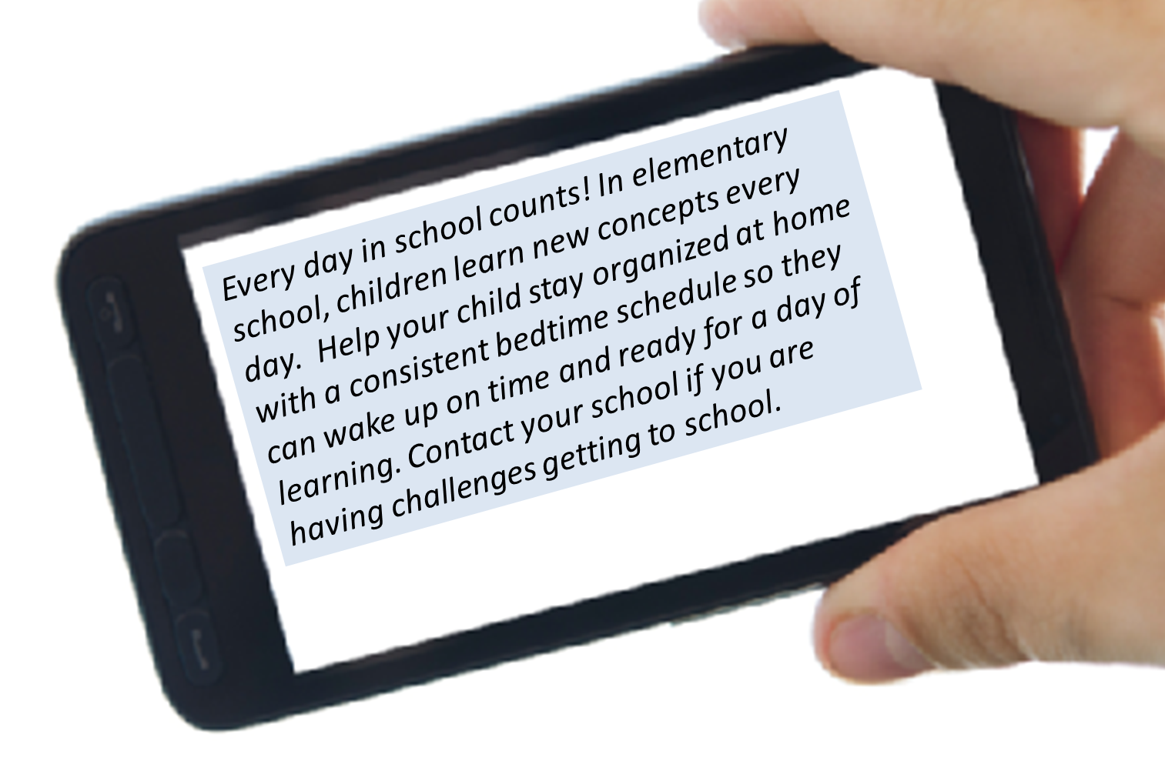
Informational Message
Notes:
Example of informational message

Slide 11
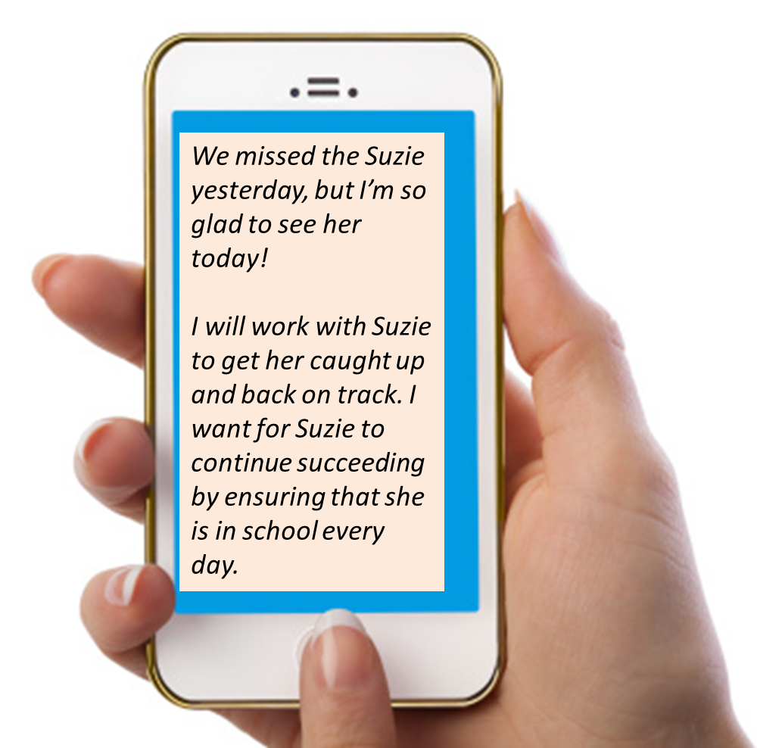
Same-Day Positive Message
Notes:
Example of same-day positive message when students return to school after having been absent.

Slide 12
2018-19 AMP Participating Schools
Anderson
Natchez
Rita Cannan
Echo Loder
Grace Warner
Desert Heights
Robert Mitchell
Lous Allen
Libby Booth
Elmcrest
Jesse Hall
Alyce Taylor

Slide 13
Getting AMPed!
Ready your systems
Prepare to respond to attendance barriers with your problem-solving teams
Encourage parents to receive text messages
Inform staff & model conversations
Know your student populations
Absenteeism by demographic group
Common attendance barriers
Get your resources in place
Share resource lists with staff & families

Slide 14
AMP Evaluation
Led by Off. of Accountability in partnership with the Intervention Dept.
Jennifer Harris & Jan Hall are lead AMP evaluators
Participatory & Utilization-Focused
Opportunity to guide evaluation process & reflect on findings
Meaningful & timely information
School & Participant Protections
Confidentiality
Passive Consent: Info letter & text opt out option

Slide 15
AMP Evaluation Questions
What are the challenges & strengths of AMP implementation?
Does AMP influence communication between school staff & parents about attendance? In what ways is communication changed by AMP (i.e. quality, frequency, with whom at school)?
Does AMP influence absenteeism?
What are the differences between students whose attendance improves & those whose attendance does not improve (e.g., student characteristics, home & school conditions, absence types)?
Notes:
Questions 1-2 focus on formative aspects of the project… essentially we want to know if this a strategy that can be scaled-up across all schools. We want to learn how to do implement the program well and learn about the pitfalls we need to avoid.
Questions 3 and 4 pertain the effectiveness of the program… does it actually work in leading to improved attendance outcomes?
Q4 looks at effectiveness of AMP across different groups of students and conditions. The answer to this question will:
Allow for tailoring of the program to specific demographics and conditions
help school leaders decide on the suitability of AMP to their school’s population when considering adopting the program.

Slide 16
AMP Evaluation
Implementation Checklist
Telephone or in-person interviews
School staff most involved with project
Sample of parents & guardians
Descriptive & inferential analyses
Change in absenteeism
Comparison groups
Control for student & school characteristics

Slide 17
WCSD Resources
Intervention Department https://www.washoeschools.net/Page/5579
Multi-Tiered System of Supports https://www.washoeschools.net/Domain/202
Family School Partnerships
https://www.washoeschools.net/Domain/161
Student Accounting https://www.washoeschools.net/Domain/180
National Resources
www.attendanceworks.org
http://absencesaddup.org
www.every1graduates.org

Slide 18
Rechelle Murillo
Intervention Coordinator
(775) 337-9913
rmurillo@washoeschools.net
Jennifer Harris
Program Evaluator
(775) 333-3766
jharris@washoeschools.net
Washoe County School District
425 East Ninth Street
Reno, NV 89520

